Slide 1
Governor Limits

Slide 2

What is Salesforce multitenancy?
What are Salesforce governor limits?
Types of Salesforce governor limits
How to overcome governor limits?
Summary

Slide 3
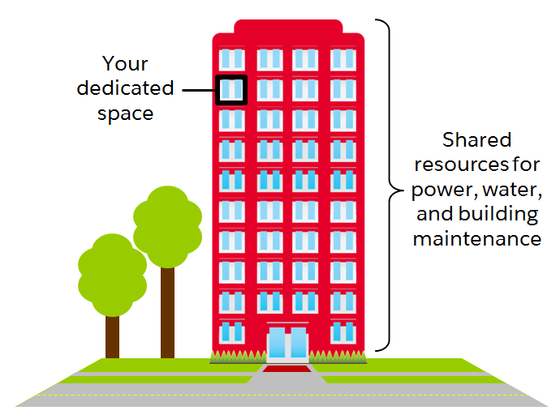
Salesforce multitenancy :
Multitenancy means a single instance of software (Salesforce) runs on a server that is able to serve multiple users.
Due to the nature of multitenancy and the fact we are sharing resources, governor limits are in place to ensure that any Apex we develop does not monopolize the shared resources we are allocated.

Slide 4
Salesforce Governor Limits :
Governor Limits are runtime constraints enforced by the Salesforce platform.
They are designed to prevent long-running or resource-intensive operations, ensuring fair resource allocation among all users.
These limits apply to various aspects of Salesforce, including Apex code, Visualforce pages, and API calls.

Slide 5
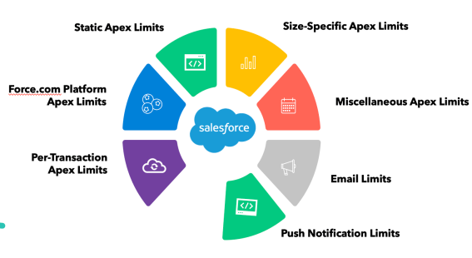
Types of Governor Limits :

Slide 6
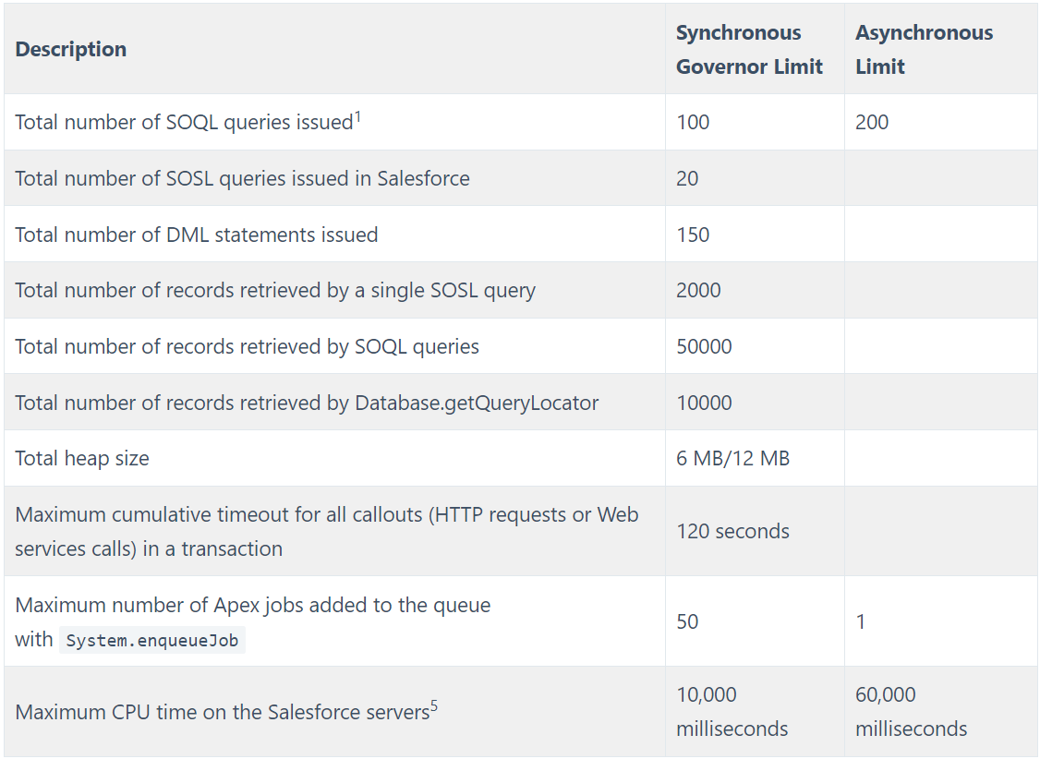
Per-Transaction Apex Limits :
These limits count for each Apex transaction. For Batch Apex, these limits are reset for each execution of a batch of records in the execute method.

Slide 7
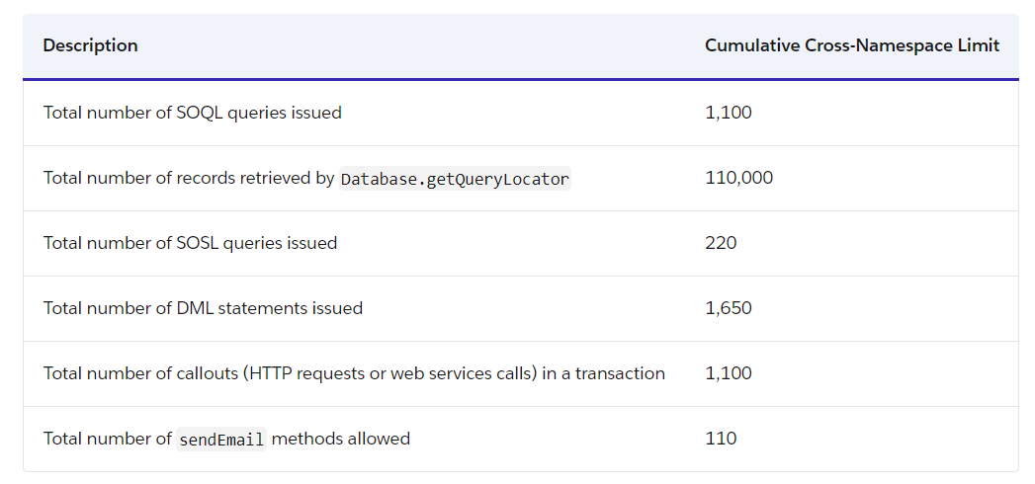
Per-Transaction Certified Managed Package Limits
A managed package developed by a Salesforce ISV has passed security review, they are provided with generally higher per-transaction limits.

Slide 8
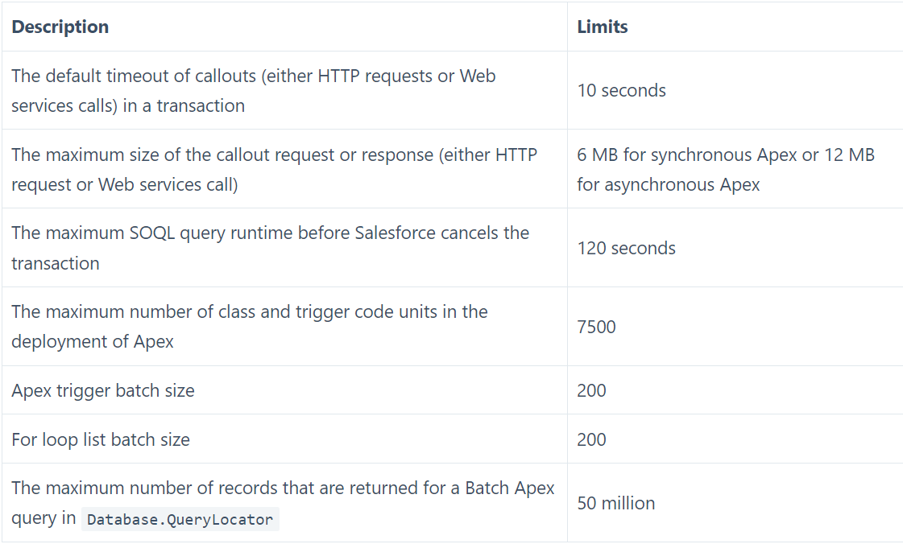
Static Apex Limits :
Apex Limits that are applied across all transactions such as: callout sizes and times, trigger code unit numbers, restricts loop and apex trigger sizes, etc

Slide 9
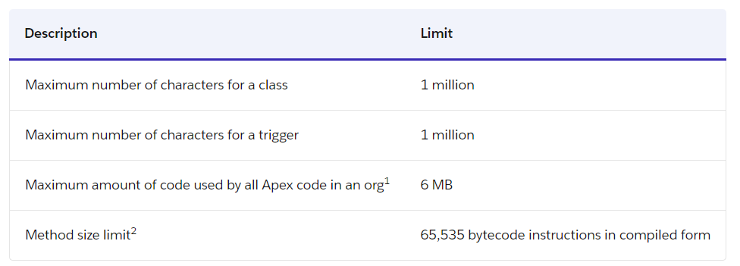
Size-Specific Apex Limits
Apex Limits related to the size of code.

Slide 10
Push Notification Limits : An org can send up to 20,000 iOS and 10,000 Android push notifications per hour (for example, 4:00 to 4:59 UTC).
Force.com platform Limits : These limits aren’t specific to an Apex Transaction and are enforced by the Lightning platform.
Email Limits :
You can send single emails to a maximum of 5,000 external email addresses per day based on Greenwich Mean Time (GMT).
You can specify up to 100 recipients for the To field and up to 25 recipients for the CC and BCC fields in each Single Email Message.

Slide 11
How to overcome governor limits :
Code Review and Optimization
Governor Limit Monitoring
Use of Limits Methods
Query and DML Statement Optimization
Bulk API and Bulk Processing

Slide 12
Summary:
In conclusion, Governor Limits in Salesforce are essential for maintaining platform stability and performance.
Developers must be mindful of these limits when designing, developing, and testing their Salesforce applications.
Adhering to best practices and using available tools will help developers work within these constraints effectively.

Slide 13
Thank You!!!
By
Ashwin Singh Thakur
Udaykrishna Modem

